Slide 1
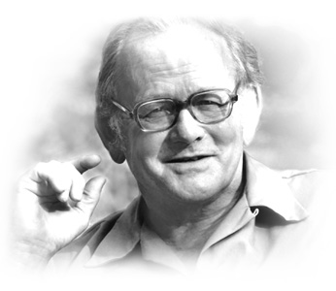
“Tragedy of the Commons and Resource Allocation,” Video Interview with Garrett Hardin
http://www.garretthardinsociety.org/videos/video_803_segment3.html

Slide 2
Contemporary Moral Problems
M-F12:00-1:00SAV 264
Instructor: Benjamin Hole
Email: bvhole@uw.edu
Office Hours: everyday after class

Slide 3
Agenda
Clicker Quiz
Context for Hardin
Collective Action Problems
Hardin’s Direct Argument

Slide 4

Please set your Turning Technology Clicker to channel 41
Press “Ch”, then “41”, then “Ch”

Slide 5
One objection to utilitarianism is that the theory is overly demanding, but there are different versions of this argument. Which of the following is not a version of the objection discussed in class yesterday?
Psychological demandingness
Substantive demandingness
Tragic demandingness
All of the above

Slide 6
Garret Hardin, in his article “Lifeboat Ethics,” argues that:
rich nations have an obligation to help poor ones whose population can be controlled
poor nations have a right to the help of rich nations
rich nations ought to help only other rich nations
rich nations have an obligation not to help poor nations whose population cannot be controlled
none of the above

Slide 7
On the proposal that we need to establish world food banks to help those who are in need, Hardin would say that:
if the proposal were to be realized, the operation must be conducted consistently
only the richer countries have some moral obligation to make deposits in the world food banks
it would be subject to the tragedy of the commons
we need to go with the idea because we ought not to punish poor people who are caught in an emergency
none of the above

Slide 8
Collective Action Problems
The Prisoner’s Dilemma
Immoralist’s Challenge
Tragedy of the Commons
International
Intergenerational

Slide 9
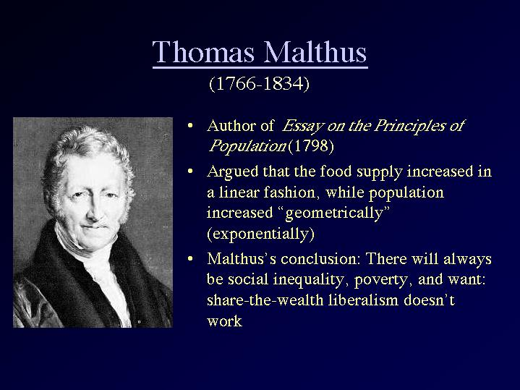
Population and Hunger

Slide 10
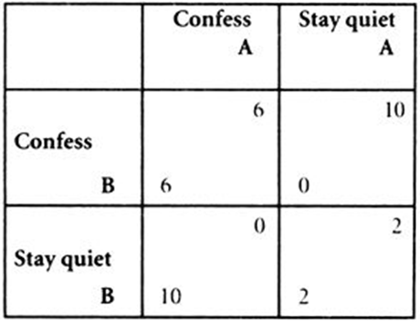
The Prisoner’s Dilemma
Individually rational to not cooperate
Collectively rational to cooperate
Standard Solutions
Appeal to fairness
Appeal to broader self-interests
http://www.investopedia.com/video/play/prisoners-dilemma/

Slide 11
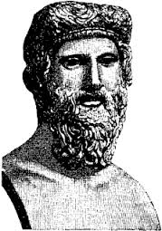
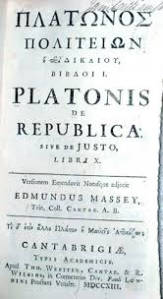

The Prisoner’s Dilemma
Individually rational to not cooperate
Collectively rational to cooperate
Standard Solutions
Appeal to fairness
Appeal to broader self-interests
http://www.youtube.com/watch?v=W3BmxyA3QPQ

Slide 12
Suppose that Gyges finds, not one ring, but two. Both rings have the same magic power. Put yourself into Gyges’ sandals. What would you do with the second ring?
http://www.youtube.com/watch?v=W3BmxyA3QPQ

Slide 13
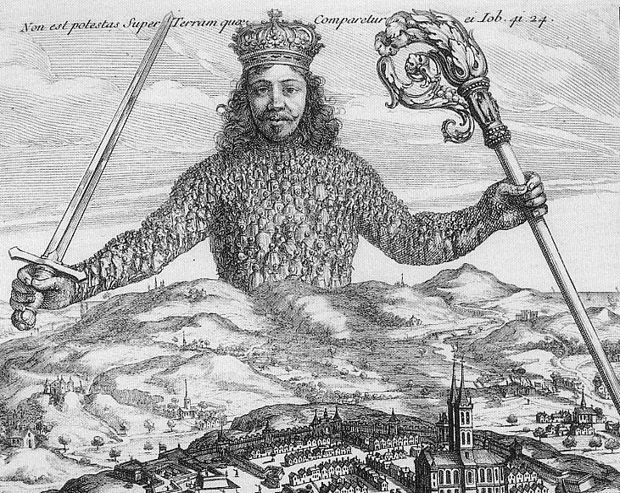
The State of Nature and Social Contract
We are rationally required to leave the state of nature and submit to a coercive authority in order to adjudicate between conflicts of individual interests.

Slide 14
The State of Nature and Social Contract
Rationality
Autonomous or Heteronomous?

Slide 15
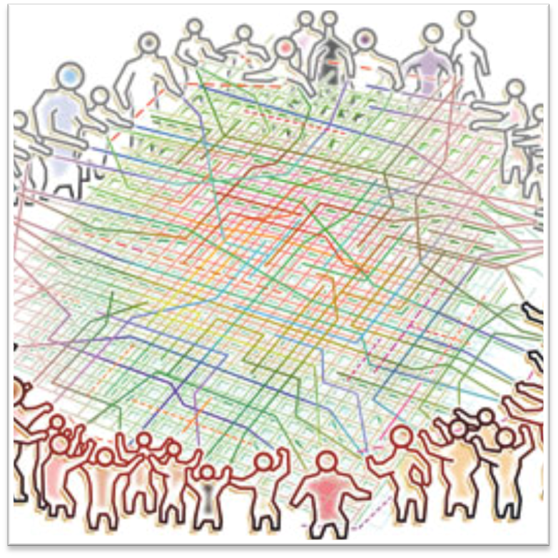
The Tragedy of the Commons
“The tragedy of the commons is a … situation in which multiple individuals, acting independently and rationally consulting their own self-interest, will ultimately deplete a shared limited resource even when it is clear that it is not in anyone's long-term interest for this to happen.”
http://www.princeton.edu/~achaney/tmve/wiki100k/docs/Tragedy_of_the_commons.html
Notes:
15

Slide 16

The International Tragedy of the Commons
State Sovereignty
Treaty of Westphalia (1648)
States as individual actors in the International state of nature.
Given state sovereignty, there is no power greater than the state.
Notes:
16

Slide 17
The International Tragedy of the Commons
Is the right solution (1) an appeal to fairness or (2) an appeal to broader self-interests?
Notes:
17

Slide 18
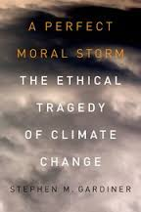
The Intergenerational Tragedy of the Commons
Each generation is an actor, across time, in an intergenerational collective action problem.
Notes:
18

Slide 19
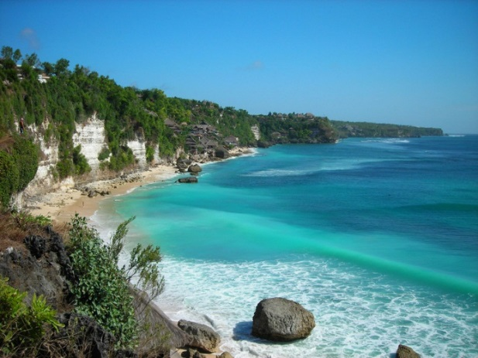
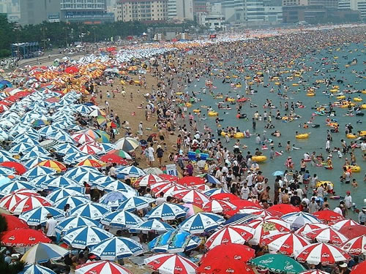
The Repugnant Conclusion
“For any possible population of … people, all with a very high quality of life, there must be some much larger imaginable population whose existence, if other things are equal, would be better even though its members have lives that are barely worth living” (Parfit 1984).

Slide 20
Is the right solution to a collective action problem is (A) an appeal to fairness or (B) an appeal to broader self-interests?
an appeal to fairness
an appeal to broader self-interests
Neither

Slide 21
Hardin’s Main Argument

Slide 22
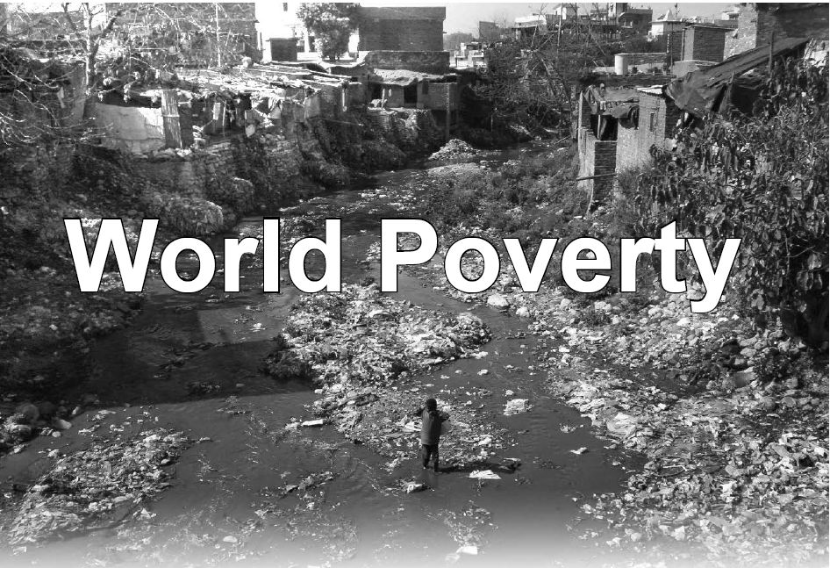
Hardin
Hardin argues that helping poverty in today's world would not do any good (and it would lead to still greater demands in the future).
He justifies this view empirically, that the giving of aid would be ineffective and counterproductive for controlling population growth.

Slide 23
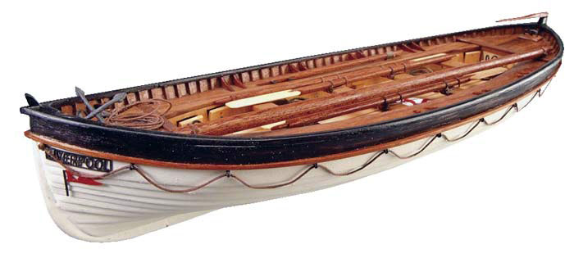
Hardin
The Lifeboat Metaphor
Rich nations are lifeboats full of rich people and poor nations are (much more crowded) lifeboats full of poor people.
The central problem of “the ethics of a lifeboat”: What should the passengers on a rich lifeboat do?
Three options:
Unlimited sharing
Selective sharing
No sharing
Hardin argues for the third option.

Slide 24
Hardin's Argument
P1. We should adopt those policies that lead to the best long term benefits for everyone.
P2. Helping the poor, in terms of a World Food Bank or liberal immigration policies, would lead to the destruction of the environment and a ruined world for future generations.
C3. It follows that we should not adopt the aforementioned policies.

Slide 25
Hardin’s Argument
Premise 1: is a straightforward utilitarian principle.

Slide 26
Hardin’s Argument
Defending Premise 2:
Tragedy of the Commons: Hardin argues that by setting up a world food bank to feed the poor or by allowing the poor to immigrate to the wealthy countries, we make food “common property”.
Aristotle claimed “that which is held in common is cared for the least.”
The collective action problem destroys incentives to produce and to wisely consume this resource and will result in accelerated depletion of the resource.

Slide 27
Hardin’s Argument
Defending Premise 2:
Reproduction: Hardin cites numerous statistics concerning the relatively high growth of population in the poorest countries compared to the lower growth rate in more prosperous countries.
Given this population trend, there is no way that the wealthy can (continue to) subsidize the poor.
The long-run result of providing famine relief now is that there will be even more living in abject poverty in the future and, at some time in the future, our ability to provide even short-term famine relief will be exhausted. Then, millions more will die of starvation because of our current efforts at famine relief.

Slide 28
Hardin’s Argument
Defending Premise 2:
Should we send information? Hardin argues that even if we could restrict our foreign aid to teaching people to provide for themselves, the fact that doing so would increase the human population would allow us to apply the lifeboat metaphor again.
“if we teach others to build their own boats, there will be too many of us fishing in the ocean.”

Slide 29
Hardin's Argument
P1. We should adopt those policies that lead to the best long term benefits for everyone.
P2. Helping the poor, in terms of a World Food Bank or liberal immigration policies, would lead to the destruction of the environment and a ruined world for future generations.
C3. It follows that we should not adopt the aforementioned policies.

Slide 30
Writing Assignment Three
Singer versus Hardin

Slide 31
Discussion, Writing Assignment
Singer and Hardin are both utilitarians and therefore accept the same theoretical rationale for what affluent people should do within the realm of international ethics. However, as a matter of practical guidance, they give us contradictory utilitarian answers. Your task is to make an argument that one philosopher’s approach is better, so your argument should criticize the way one of the philosophers makes use of utilitarian ethical theory in the realm of international ethics. Remember, in order to engage, your argument should criticize a premise from one of the philosophers.

Slide 32
Who has the better argument?
Hardin
Singer
Neither

